Slide 1
Cook-DuPage Smart Corridors
John Noel Public Transit Conference
Illinois Department of Transportation
John Baczek, P.E.
October 13, 2017

Slide 2
Agenda
Transit and ITS
ITS and IDOT – a long history
Cook DuPage Corridor Study
IDOT – Smart Corridor Project
Next Steps
Notes:
Thanks John and Good morning to everyone
Today I will be providing an overview of the Cook-DuPage SMART Corridors study
I will provide some insight as to why transit is important…especially to IDOT
I will discuss the link between transit and ITS and some of our history with ITS
Then we will go over the Cook-DuPage SMART Corridor project
And discuss next steps.

Slide 3
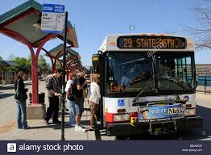
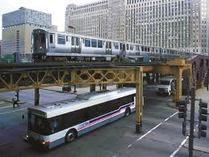
Transit and ITS
Why is transit important?
Limited funding to expand system
Increasing population
Gives stakeholders choices
Helps maximize use of existing system
Reduces congestion
Notes:
Transit and ITS
Why is transit important especially to IDOT?
First off funding for roadway expansion is scarce.
About 85% of our budget goes to maintenance!
Population is growing in sheer number of people
Having options for travel increases mobility
Transit helps increase the movement of higher volumes of people
while maximizing the use of the existing system
Reduces congestion
Improves quality of life!

Slide 4
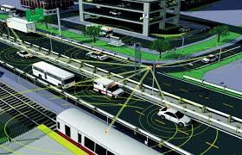
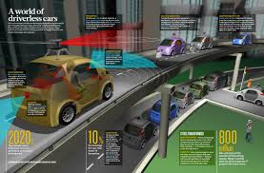
Transit and ITS
Intelligent Transportation Systems (ITS)
“…aims to provide innovative services relating to different modes of transport and traffic management and enable various users to be better informed and make safer, more coordinated, and 'smarter' use of transport networks.”
ITS in transit world is changing rapidly
Electronic fare collections, scheduling, routing, social media
More to come with connected vehicles and autonomous vehicles
Notes:
Transit and ITS
What is ITS????
Intelligent Transportation Systems (ITS)
According to wikipedia…
“ITS…aims to provide innovative services relating to different modes of transport and traffic management and enable various users to be better informed and make safer, more coordinated, and 'smarter' use of transport networks.”
ITS in transit world is changing rapidly
Electronic fare collections, scheduling, routing, social media
More to come with connected vehicles and autonomous vehicles

Slide 5
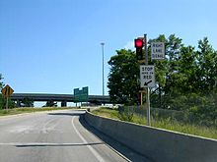
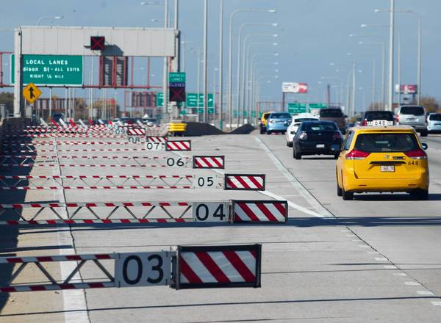
ITS and IDOT History
A history of innovation
1960 Emergency Traffic Patrol “The Minutemen”
1961 Reversible lanes on the Kennedy Expressway
1962 Nations 1st pavement traffic detectors
1963 Nations 1st computerized expressway surveillance system
Oak Park Traffic Systems Center
1963 Ramp metering on the Eisenhower Expressway
Notes:
IDOT has a history of using ITS technology to manage highways.
Early Efforts include
1960 - the Emergency Traffic Patrol began to assist stranded motorists and was instantly a public success.
1961 - Kennedy (Northwest) Expressway Reversible Lanes
1962 – Nations first pavement traffic detectors
1963 – nations first computerized traffic systems center (Oak Park Traffic Systems Center)
Also in 1963 - First use of ramp metering in the US was in Chicago on the Eisenhower Expressway – traffic officers would stand at ramps and release vehicles. Based on the success of these trials, these soon became signalized ramp meters and were expanded to other expressway locations

Slide 6
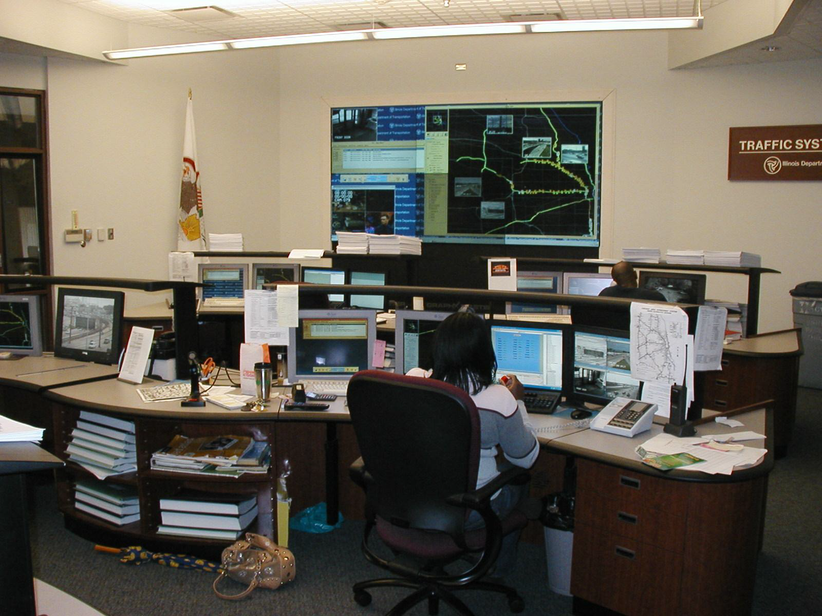
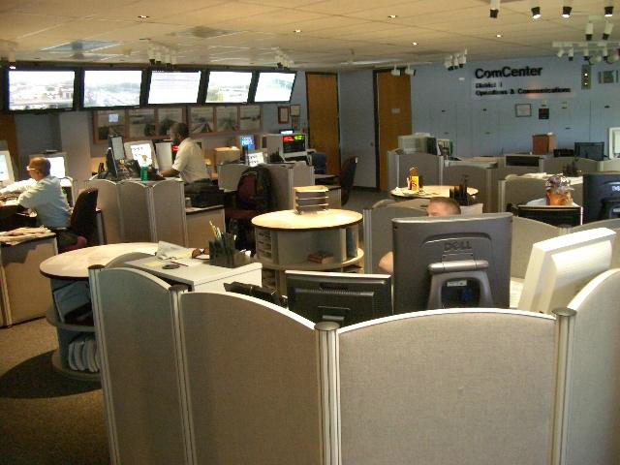
ITS and IDOT History
Through the years:
IDOT ITS Program Office formed
Expansion of route guidance and “real time” traffic data (before Google maps and Waze)
Highway advisory radio
Media outlets
Gary-Chicago-Milwaukee (GCM)
Multi-state and multi-modal info system
Transit, commercial vehicles, traffic and incident management
Travel Midwest and Getting Around Illinois
Notes:
Through the years:
IDOT ITS Program Office was formed
Expansion of route guidance and “real time” traffic data (before Google maps and Waze)
Highway advisory radio
Media outlets
Gary-Chicago-Milwaukee (GCM)
Multi-state and multi-modal traveler information system
Transit, commercial vehicles, traffic and incident management
This information source has evolved into Travel Midwest and Getting Around Illinois

Slide 7
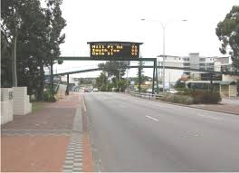
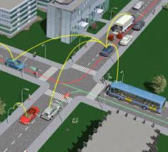
ITS and IDOT History
How can ITS and other practices ready us for the changes?
Many “gaps” in the arterial system
Coordinated traffic signals
Transit signal priority
Travel time information and route guidance
Pedestrian push button actuation and signal heads
Sidewalk links to bus stops
Notes:
There are many other less glamorous ITS practices IDOT has been implementing
throughout the highway system but there are gaps that could be addressed
to put us in a better position to adapt to the coming changes.
Things like:
Expanding use of Transit signal priority
Providing arterial Travel time information and route guidance
Pedestrian push button actuation and signal heads
Sidewalk links to bus stops
And other things that will improve transit access and connectivity to other modes

Slide 8
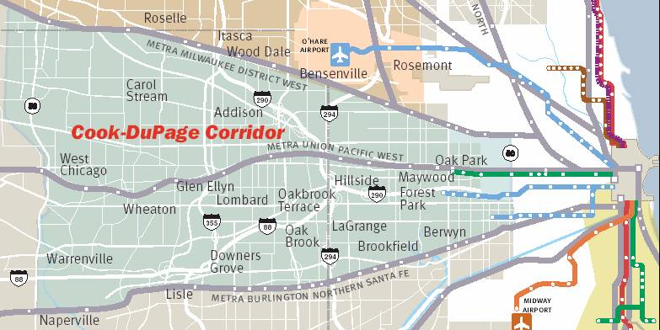
Cook DuPage Corridor
Cook DuPage Corridor
CATS 2030 Transportation Plan
Centered on I-290 and I-88
30 miles from Cicero Ave to Kane-DuPage Co Line
300 square miles
51 municipalities
1.1 million people
750,000 jobs
800,000 work trips a day
65,000 pass-though trips
Identify effective and sustainable transportation solutions
Notes:
Stakeholders in Cook and DuPage county believed there to be
some opportunities for transportation improvement.
Because of that interest, the Corridor was one of several corridors
recommended for multi-modal analysis in the 2003 Chicago Area Transportation Study (CATS) 2030 Regional Transportation Plan.
The corridor includes the area bounded by the Kane-DuPage County Line on the west, IL 50 (Cicero Avenue) on the east, the Metra Milwaukee District Line on the north, and the Metra Burlington Northern Santa Fe on the south.
Centered on I-290 and I-88
30 miles from Cicero Ave to Kane-DuPage Co Line
300 square miles
51 municipalities
1.1 million people
750,000 jobs
800,000 work trips a day
65,000 pass-though trips
Goal of the study was to identify effective and sustainable transportation solutions for this corridor

Slide 9
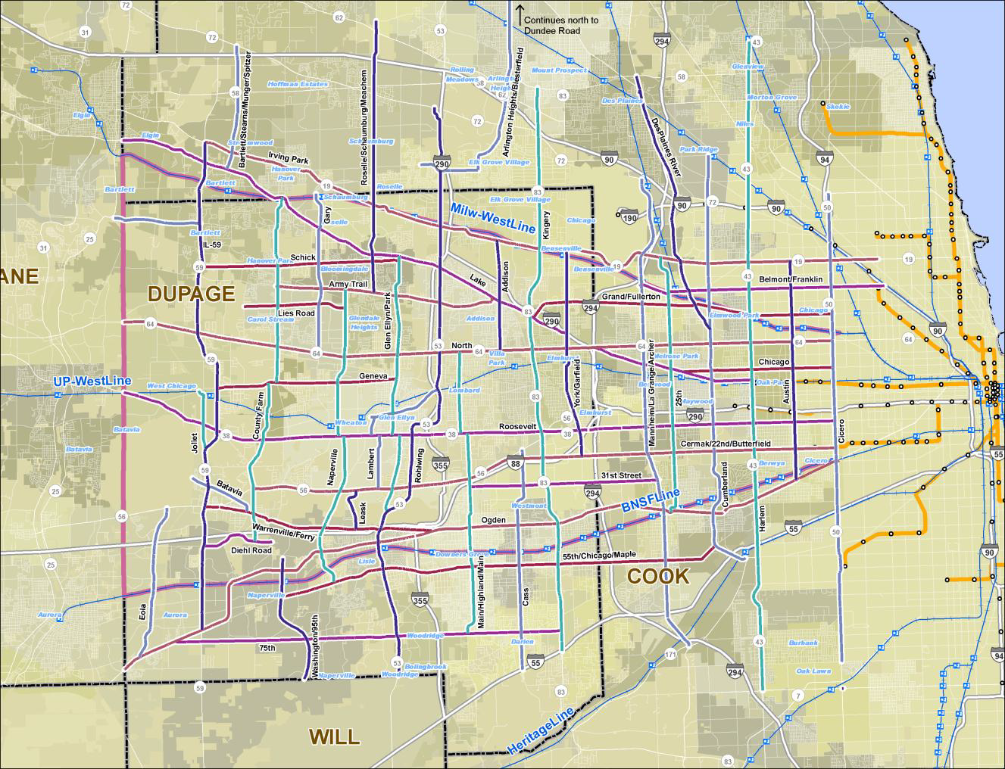
Cook DuPage Corridor
Cook DuPage Corridor Study
Collaborative long term study Led by the RTA
Long-range major multi-modal transportation investments
New transit (Blue Line Extension)
Adding managed lanes (I-290 study)
Complementary but relatively less capital intensive network enhancements (Such integrating new/more ITS related strategies and making the existing roads “smarter”)
46 candidate arterials
Notes:
The Cook DuPage Corridor Study was lead by the Regional Transportation Authority (RTA)
in cooperation with the Illinois Department of Transportation (IDOT),
the Illinois State Toll Highway Authority (ISTHA), Chicago Metropolitan Agency for Planning (CMAP),
Chicago Transit Authority (CTA), Metra and Pace, Cook and DuPage counties, and the many communities in the study area.
It was a collaborative transportation planning effort to identify,
develop and recommend long range,
major MULTI_MODAL transportation investments
to improve mobility in this heavily-traveled portion of our region.
The resulting vision is comprised of two distinct components:
Potential proposed major capital investments
Like a potential CTA Blue Line Extension to Oak Brook
As well as additional capacity on I-290
(2) A set of relatively less capital-intensive network enhancements
like improving traffic signal interconnections
transit signal priority
Dynamic Message Boards with travel times and route guidance
Improved transit access linkages
The goal here was to make the existing routes better or SMARTER!
The report identified 46 candidate arterial corridors for consideration for network enhancements

Slide 10
Cook DuPage Smart Corridor Study
On-Going Studies
IDOT/CTA Blue Line Extension
IDOT I-290 Managed Lanes Study
Smart Corridor Study
Sponsored by West Central Municipal Conference
Improve travel for all modes
Low cost solutions
Manage the corridor with ITS
Notes:
At the time of the study, IDOT and CTA were in the process of studying both
the Blue Line Extension as well as the I-290 managed lanes.
So the focus was on the remaining arterial improvements
Which was renamed the Smart Corridors study.
Intent was to identify travel related improvements
for all modes of transportation
through low-cost solutions and Intelligent Transportation Systems.

Slide 11
Cook DuPage Smart Corridor Study
Cook DuPage Smart Corridor Study
46 to 4 candidate corridors
IL 56/22nd/Cermak
IL 43 (Harlem Avenue)
IL 64 (North Avenue)
IL 38 (Roosevelt Road)
Notes:
The study ranked the corridors using an analytical, data driven process which included 11 different categories.
Travel Market Linkage, level of congestion,
land use density, existing ITS infrastructure,
number of connections to travel centers, traffic volumes,
transit performance, crash history, significance of corridor, length of corridor, and whether they were truck routes.
The study narrowed the candidate arterials from 46 down to 4
IL 56 (Cermak/22nd/Butterfield),
IL 43 (Harlem Avenue),
IL 64 (North Avenue),
and IL 38 (Roosevelt Road)

Slide 12
IDOT Smart Corridor Study
Cook DuPage Smart Corridor Study
Pilot project
IL 56/22nd/Cermak Road
24 miles, 69 TS’s
IL 64 (North Avenue)
28 miles, 70 TS’s
IDOT SMART Corridor Study
Phase I Studies by County
Cook County (to coincide with completion of I-290 EIS)
DuPage County
Notes:
The study also recommended implementing a pilot project
To help determine the benefits of the smart corridor.
The timing was good since advancing improvements to arterials
That paralleled I-290 would be a potential benefit
For the maintenance of traffic.
IDOT selected two corridors to begin Phase I preliminary engineering;
IL 64 and IL 56 which is about 24 miles long with 69 traffic signals
And Cermak Road/22nd Street which is about 28 miles with 70 traffic signals
Given that the I-290 EIS was nearing completion,
There was interest in making sure that the SMART corridor study
Could be completed to coincide with I-290 construction should it advance.

Slide 13
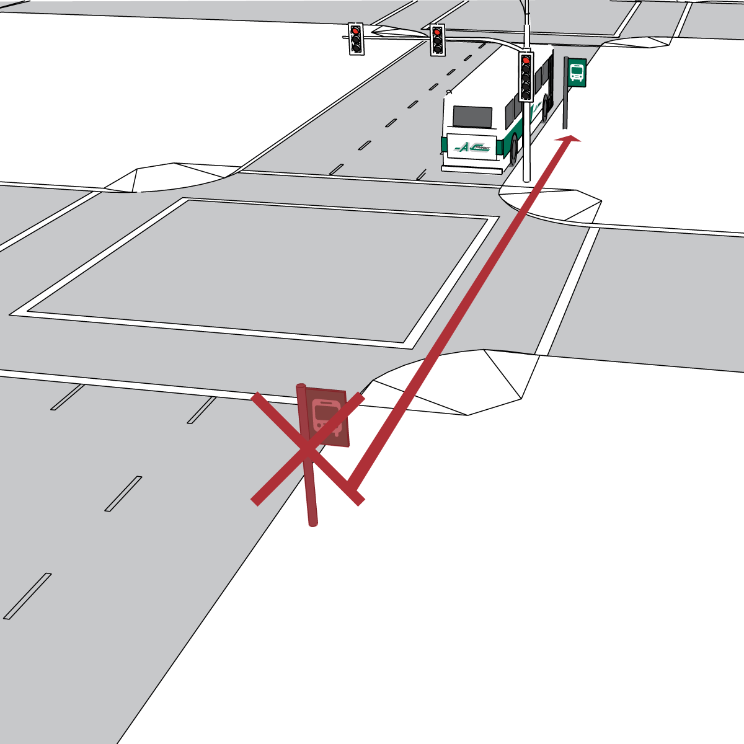
IDOT Smart Corridor Study
Phase I Study Considerations
Public Transit
Transit Signal Priority (TSP)
Traffic Signal Interconnections
Far Side Bus Stop Relocations
Pedestrian paths from bus stop to intersection
Notes:
The study recommended Transit related improvements such as:
Transit Signal Priority – PACE and CTA
will be able to provide faster and more reliable service
throughout the corridors…which could help to increased ridership.
Traffic Signal Interconnections – The corridors consisted of
many small interconnect segments which could be linked together
to improve network capacity as well as efficiency
The project also includes the evaluation of 100 near side bus stops
to determine the constraints in relocating them
to the far side of signalized intersections which reduces potential
for buses having to stop at green lights and then get stuck
at the signal with a signal change.
It also reduces the safety concerns with vehicles turning right in front of the bus.
Then of course improving transit access and connectivity by
Providing pedestrian crossing improvements
And insuring there are sidewalk links to isolated bus stops.

Slide 14
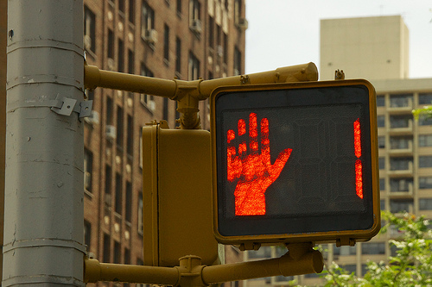
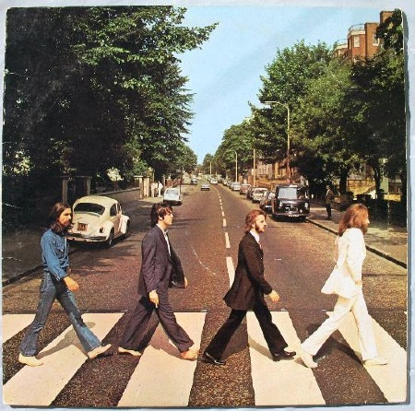
IDOT Smart Corridor Study
Phase I Study Considerations
Pedestrian
ADA Compliance at Signalized Intersections
Pedestrian countdowns
Pedestrian push buttons
High visibility crosswalks
Sidewalk gap study in Cook County
Notes:
The study also included other pedestrian related improvements such as:
ADA Compliance at Signalized Intersections
Pedestrian countdowns
Pedestrian push buttons
High visibility crosswalks
And conducting a Sidewalk gap study
to see where there may be additional opportunities
For improvements.

Slide 15
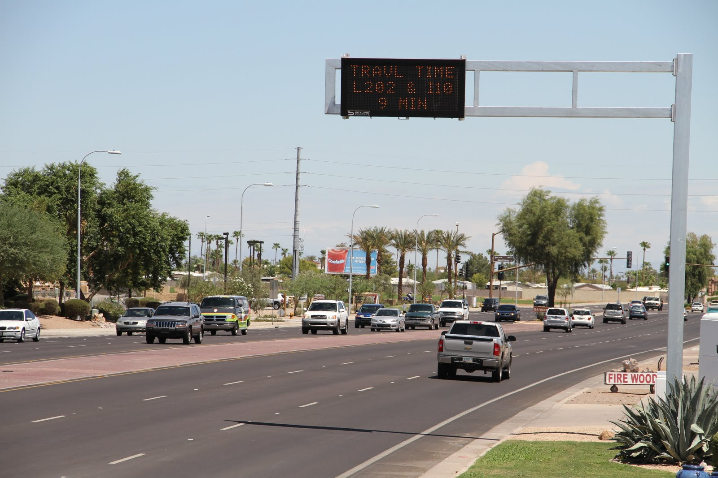
IDOT Smart Corridor Study
Phase I Study Considerations
Other Improvements
Dynamic Message Signs
Travel Time Monitoring
Closed Circuit Television Cameras (CCTV)
Emergency Vehicle Pre-emption
Notes:
Other recommended improvements include:
Dynamic Message Signs – at strategic locations along the corridor
to provide information to travelers prior to decision points.
Primarily to provide travel times and safety messages,
but also can provide incident information or AMBER alerts.
Travel Time Monitoring – provided along the corridor
to be displayed on the DMS signs and on the Travel Midwest website
CCTV Cameras – will be strategically placed along the corridor
to enable monitoring of the traveled way
which will be use to actively manage the roadway.
EVP – work with locals to fill in any gaps in EVP

Slide 16
IDOT Smart Corridor Study
Agency Coordination
DuPage County
Cook County
Illinois Tollway
City of Chicago
PACE/CTA
RTA
27 Municipalities
Other Projects
North Avenue Corridor Study (PACE)
Cermak Road Transit Signal Priority (PACE)
PULSE (PACE)
IL 64 & I-294 (Northlake)
North Avenue Streetscape (River Forest & Elmwood Park)
Ongoing ADA and resurfacing (IDOT)
Notes:
A key aspect of the project is the number of agencies and municipalities
that are impacted by the project.
The project will include coordination with the counties,
Illinois Tollway, public transit agencies,
and the multiple municipalities within the study limits.
There are also other projects that are ongoing
within the corridors that will be coordinated within the project such as:
North Avenue Corridor Study (PACE)
Cermak Road Transit Signal Priority (PACE)
Other priority PACE corridors covered by PULSE program (PACE)
IL 64 & I-294 (Northlake)
North Avenue Streetscape (River Forest & Elmwood Park)
Ongoing ADA and resurfacing (IDOT)

Slide 17
Next Steps
Cook County completion in Summer 2018
DuPage County completion in Winter 2018
No funding beyond Phase I
Notes:
Cook County completion in Summer 2018
DuPage County completion in Winter 2018
No funding beyond Phase I but we look to fund it in future programs.

